Slide 1
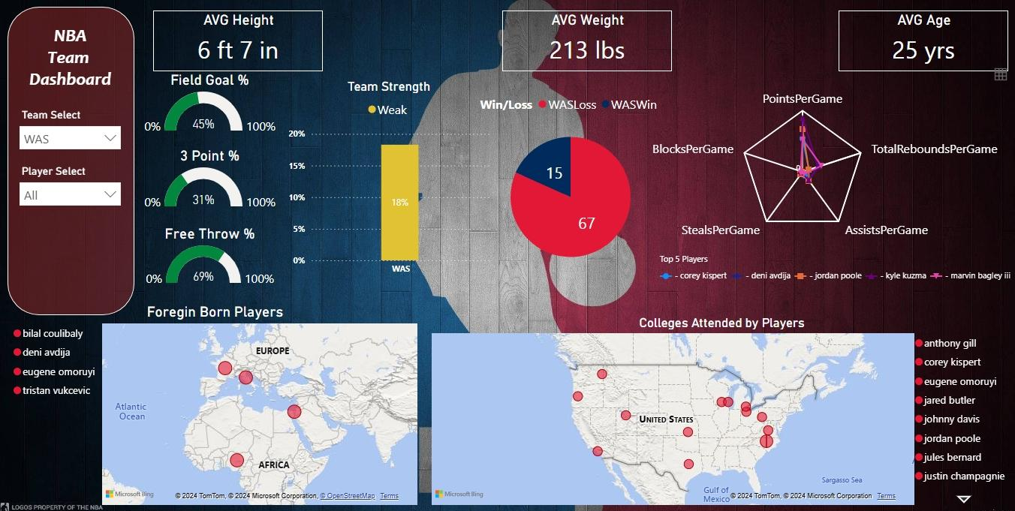
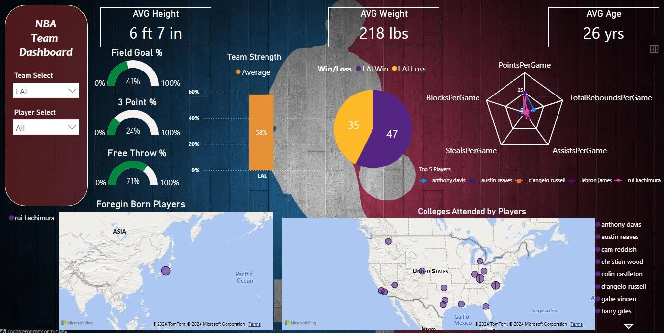
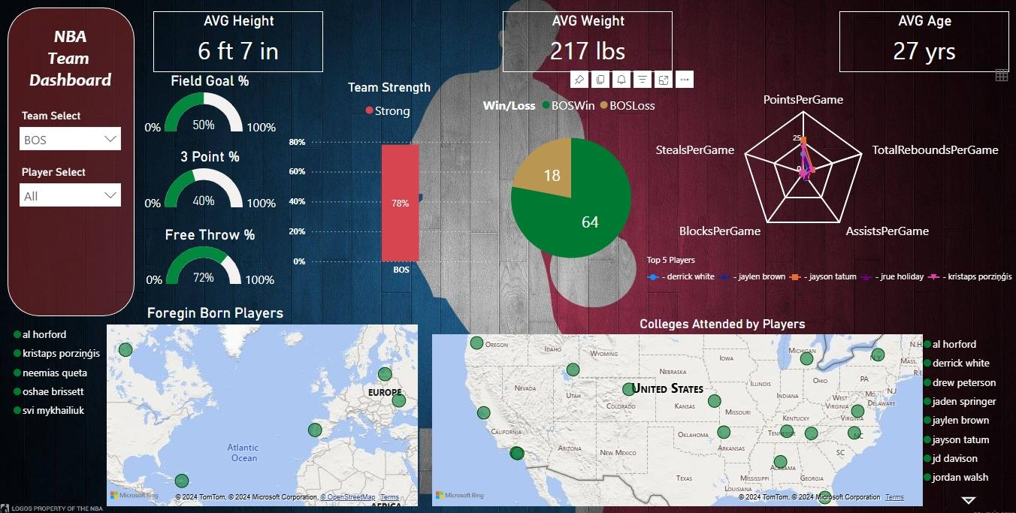
NBA Team Dashboard
Filters/Slicers:
1) Team Select ( A single value dropdown, which you can flip through all 30 teams)
2) Player Select ( A multiple value dropdown, which you can select one or more players from that team)
Maps:
Colleges Players Attended
Foreign Born Players
KPIs: (Key Performance Indicators)
Win/Loss Record
Win Rate Percentage
Avg Age
Avg Height
Avg Weight
Three Point Percentage
Field Goal Percentage
Free Throw Percentage
Points (PG)
Assist (PG)
Total Rebounds (PG)
Steals (PG)
Blocks (PG)
(PG) = Per Game

Slide 2

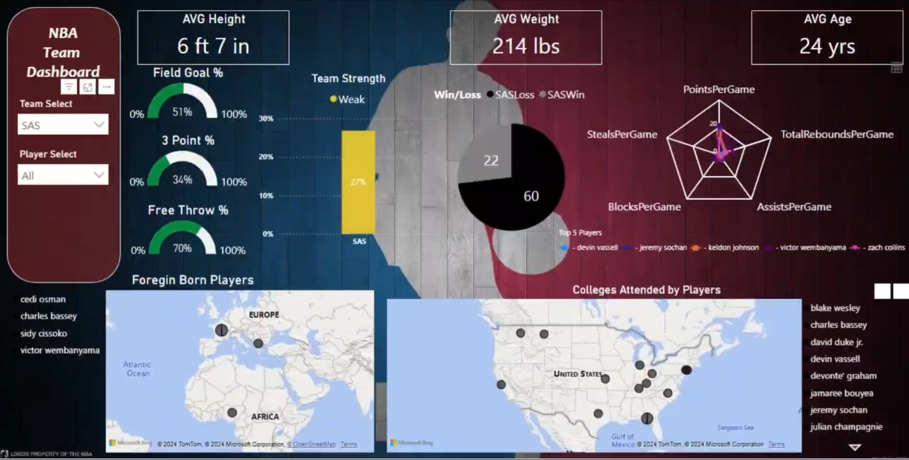
Video Example

